Slide 1
INTRO to DATA SCIENCE Cluster ANALYSIS

Slide 2
I. cluster analysis II. The K-means Algorithm III. Choosing K IV. Example
agenda

Slide 3
I. cluster analysis
INTRO TO DATA SCIENCE

Slide 4
Cluster analysis
continuous categorical
supervised ??? ???
unsupervised ??? ???

Slide 5
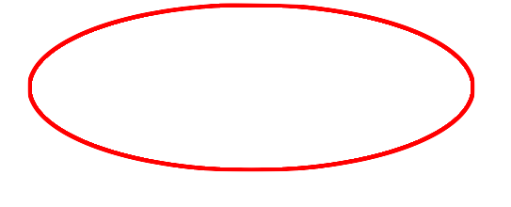
Logistic regression
continuous categorical
supervised regression classification
unsupervised dimension reduction clustering

Slide 6
Cluster analysis
Q: What is a cluster?

Slide 7
Cluster analysis
Q: What is a cluster?
A: A group of similar data points.
Notes:
Similar is a loaded word here!

Slide 8
Cluster analysis
Q: What is a cluster?
A: A group of similar data points.
The concept of similarity is central to the definition of a cluster, and therefore to cluster analysis.
Notes:
We will tighten up the concept of similarity when we discuss implementation.

Slide 9
Cluster analysis
Q: What is a cluster?
A: A group of similar data points.
The concept of similarity is central to the definition of a cluster, and therefore to cluster analysis.
In general, greater similarity between points leads to better clustering.

Slide 10
Cluster analysis
Q: What is the purpose of cluster analysis?

Slide 11
Cluster analysis
Q: What is the purpose of cluster analysis?
A: To enhance our understanding of a dataset by dividing the data into groups.

Slide 12
Cluster analysis
Q: What is the purpose of cluster analysis?
A: To enhance our understanding of a dataset by dividing the data into groups.
Clustering provides a layer of abstraction from individual data points.
Notes:
Useful for understanding, inference, platform for further analysis

Slide 13
Cluster analysis
Q: What is the purpose of cluster analysis?
A: To enhance our understanding of a dataset by dividing the data into groups.
Clustering provides a layer of abstraction from individual data points.
The goal is to extract and enhance the natural structure of the data
Notes:
Useful for understanding, inference, platform for further analysis

Slide 14
Cluster analysis
Clustering can be useful in a wide variety of domains, including genetics, consumer internet and business.
Notes:
Useful for understanding, inference, platform for further analysis
http://www-users.cs.umn.edu/~kumar/dmbook/ch8.pdf Helpful examples

Slide 15
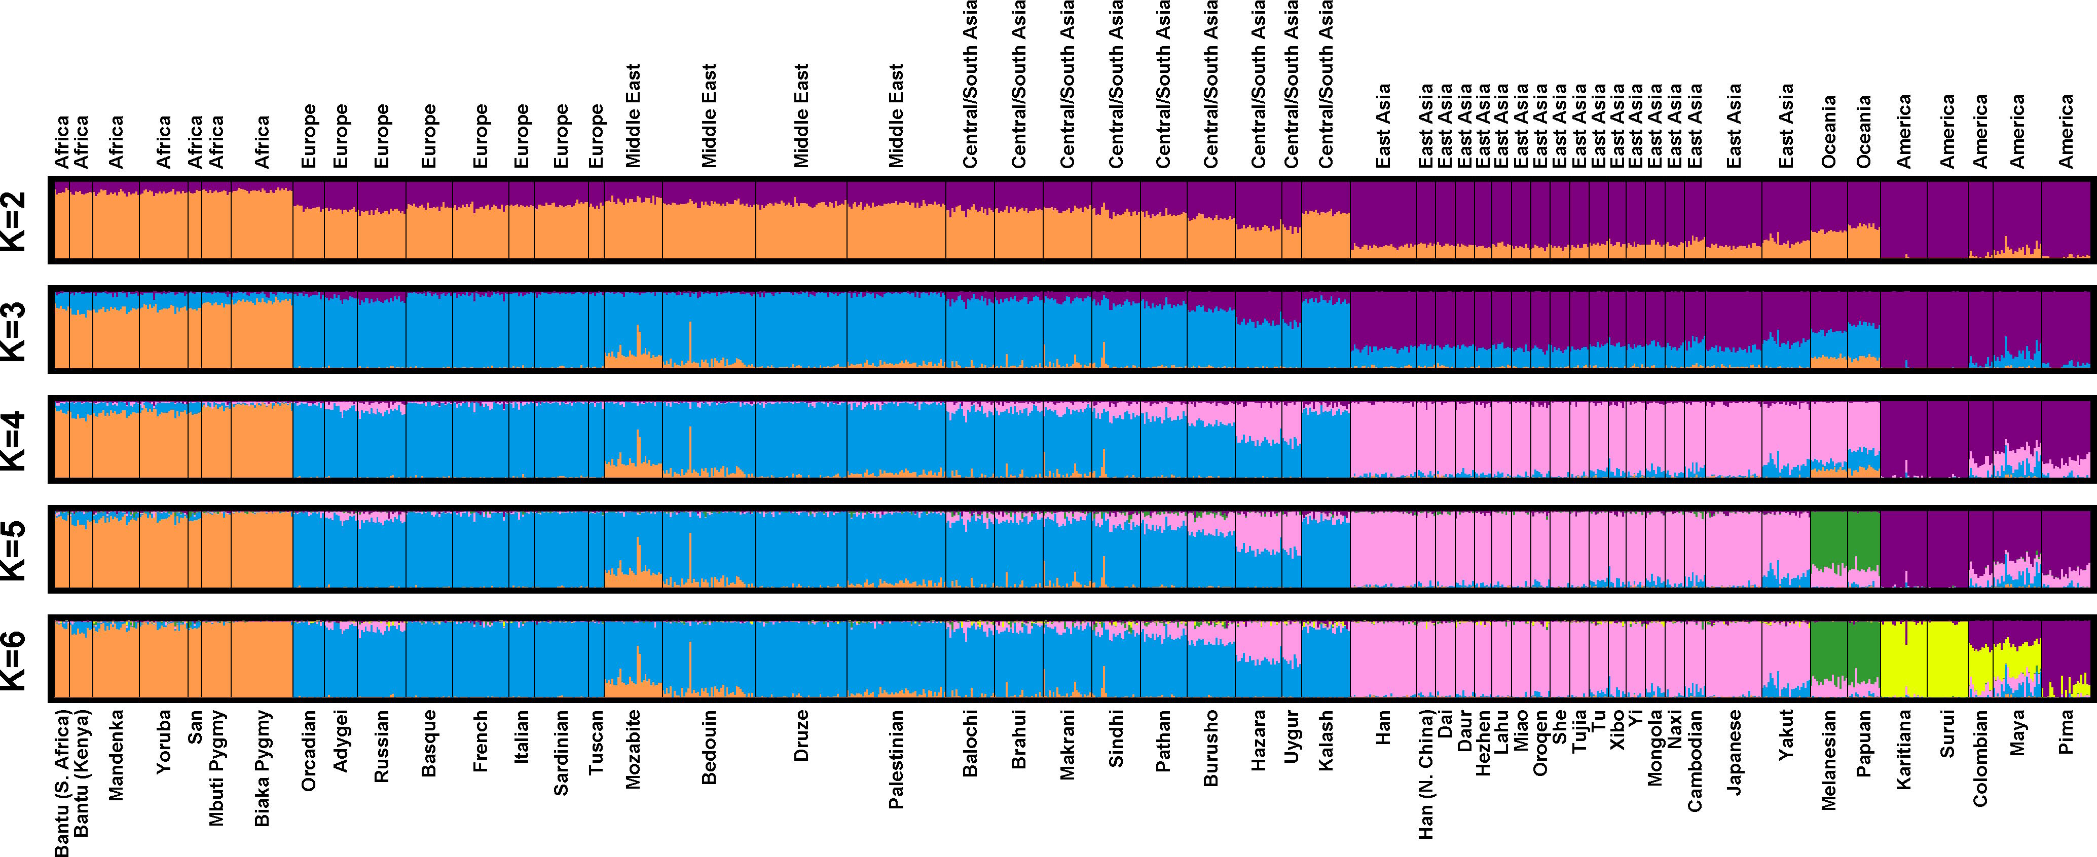
Cluster analysis
Clustering can be useful in a wide variety of domains, including genetics, consumer internet and business.
Notes:
http://www-users.cs.umn.edu/~kumar/dmbook/ch8.pdf

Slide 16

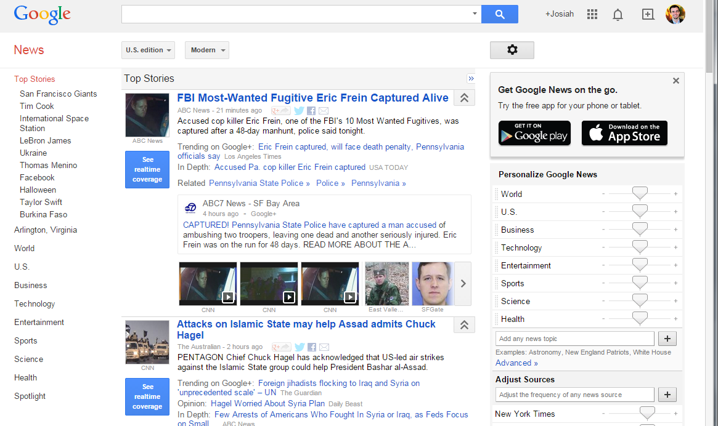
Cluster analysis
Clustering can be useful in a wide variety of domains, including genetics, consumer internet and business.
Notes:
Useful for understanding, inference, platform for further analysis

Slide 17

Cluster analysis
Clustering can be useful in a wide variety of domains, including genetics, consumer internet and business.
http://i.huffpost.com/gen/1563531/thumbs/o-GROCERY-STORE-facebook.jpg
Notes:
Useful for understanding, inference, platform for further analysis

Slide 18
Cluster analysis
There are many kinds of classification procedures. For our class, we will be focusing on K-means clustering, which is one of the most popular clustering algorithms.
K-means is an iterative method that partitions a data set into k clusters.
Notes:
Not all clustering algorithms separate the data set into mutually exclusive partitions (e.g., Agglomerative Hierarchical Clustering).

Slide 19
II. K-means clustering
INTRO TO DATA SCIENCE

Slide 20
K-means clustering
Q: How does the algorithm work?

Slide 21
The basic K-means algorithm
1) choose k initial centroids (note that k is an input)
2) for each point:
- find distance to each centroid
- assign point to nearest centroid
3) recalculate centroid positions
4) repeat steps 2-3 until stopping criteria met
Notes:
** write this on the whiteboard **

Slide 22
Step 1 – Choosing initial centroids
Q: How do you choose the initial centroid positions?
Notes:
Note: hierarchical clustering is comp expensive, but does not require initial choice of centroids

Slide 23
Step 1 – Choosing initial centroids
Q: How do you choose the initial centroid positions?
A: There are several options:
Notes:
Note: hierarchical clustering is comp expensive, but does not require initial choice of centroids

Slide 24
Step 1 – Choosing initial centroids
Q: How do you choose the initial centroid positions?
A: There are several options:
- randomly (but may yield divergent behavior)
Notes:
Most general technique, good place to start (div behavior is always possible in a greedy scheme)

Slide 25
Step 1 – Choosing initial centroids
Q: How do you choose the initial centroid positions?
A: There are several options:
- randomly (but may yield divergent behavior)
- perform alternative clustering task, use resulting centroids as
initial k-means centroids
Notes:
Note: hierarchical clustering is comp expensive (in this case, should sample data), but does not require initial choice of centroids

Slide 26
Step 1 – Choosing initial centroids
Q: How do you choose the initial centroid positions?
A: There are several options:
- randomly (but may yield divergent behavior)
- perform alternative clustering task, use resulting centroids as
initial k-means centroids
- start with global centroid, choose point at max distance, repeat (but might select outlier)
Notes:
Dealing with outliers in clustering is another topic (remove, don’t remove, detection)

Slide 27
Step 2 – Assess similarity
Q: How do you determine which centroid a given point is most similar to?

Slide 28
Step 2 – Assess similarity
Q: How do you determine which centroid a given point is most similar to?
The similarity criterion is determined by the measure we choose.

Slide 29
Step 2 – Assess similarity
Q: How do you determine which centroid a given point is most similar to?
The similarity criterion is determined by the measure we choose.
In the case of k-means clustering, the similarity metric is the Euclidian distance:

Slide 30
Step 2 – Assess similarity
Q: How do you determine which centroid a given point is most similar to?
The similarity criterion is determined by the measure we choose.
In the case of k-means clustering, the similarity metric is the Euclidian distance:

Slide 31
Step 3 – Recomputing the Center
Q: How do we recompute the positions of the centers at each iteration of the algorithm?
A: By calculating the centroid (i.e., the geometric center)
Notes:
Results should be pretty consistent for various choices of metric.

Slide 32
Step 4 – convergence
We iterate until some stopping criteria are met; in general, suitable convergence is achieved in a small number of steps.
Notes:
4 or 5 steps is usual

Slide 33
Step 4 – convergence
We iterate until some stopping criteria are met; in general, suitable convergence is achieved in a small number of steps.
Stopping criteria can be based on the centroids (eg, if positions change by no more than ε) or on the points (eg, if no more than x% change clusters between iterations).

Slide 34
The basic K-means algorithm
1) choose k initial centroids (note that k is an input)
2) for each point:
- find distance to each centroid
- assign point to nearest centroid
3) recalculate centroid positions
4) repeat steps 2-3 until stopping criteria met
x₁
x₂
Notes:
** write this on the whiteboard **

Slide 35
The basic K-means algorithm
1) choose k initial centroids (note that k is an input)
2) for each point:
- find distance to each centroid
- assign point to nearest centroid
3) recalculate centroid positions
4) repeat steps 2-3 until stopping criteria met
x₁
x₂
Notes:
** write this on the whiteboard **

Slide 36
The basic K-means algorithm
1) choose k initial centroids (note that k is an input)
2) for each point:
- find distance to each centroid
- assign point to nearest centroid
3) recalculate centroid positions
4) repeat steps 2-3 until stopping criteria met
x₁
x₂
Notes:
** write this on the whiteboard **

Slide 37
The basic K-means algorithm
1) choose k initial centroids (note that k is an input)
2) for each point:
- find distance to each centroid
- assign point to nearest centroid
3) recalculate centroid positions
4) repeat steps 2-3 until stopping criteria met
x₁
x₂
Notes:
** write this on the whiteboard **

Slide 38
The basic K-means algorithm
1) choose k initial centroids (note that k is an input)
2) for each point:
- find distance to each centroid
- assign point to nearest centroid
3) recalculate centroid positions
4) repeat steps 2-3 until stopping criteria met
x₁
x₂
Notes:
** write this on the whiteboard **

Slide 39
The basic K-means algorithm
1) choose k initial centroids (note that k is an input)
2) for each point:
- find distance to each centroid
- assign point to nearest centroid
3) recalculate centroid positions
4) repeat steps 2-3 until stopping criteria met
x₁
x₂
Notes:
** write this on the whiteboard **

Slide 40
The basic K-means algorithm
1) choose k initial centroids (note that k is an input)
2) for each point:
- find distance to each centroid
- assign point to nearest centroid
3) recalculate centroid positions
4) repeat steps 2-3 until stopping criteria met
x₁
x₂
Notes:
** write this on the whiteboard **

Slide 41
The basic K-means algorithm
1) choose k initial centroids (note that k is an input)
2) for each point:
- find distance to each centroid
- assign point to nearest centroid
3) recalculate centroid positions
4) repeat steps 2-3 until stopping criteria met
x₁
x₂
Notes:
** write this on the whiteboard **

Slide 42
The basic K-means algorithm
1) choose k initial centroids (note that k is an input)
2) for each point:
- find distance to each centroid
- assign point to nearest centroid
3) recalculate centroid positions
4) repeat steps 2-3 until stopping criteria met
x₁
x₂
Notes:
** write this on the whiteboard **

Slide 43
III. Cluster validation
INTRO TO DATA SCIENCE

Slide 44
Cluster validation
In general, k-means will converge to a solution and return a partition of k clusters, even if no natural clusters exist in the data.

Slide 45
Cluster validation
In general, k-means will converge to a solution and return a partition of k clusters, even if no natural clusters exist in the data.
We will look at two validation metrics useful for partitional clustering, cohesion and separation.
Notes:
Note: these are unsupervised validation metrics (don’t depend on external info)
There is a duality between unsup validation metrics & objective funcs

Slide 46
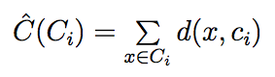
Cluster validation
Cohesion measures clustering effectiveness within a cluster.
Notes:
Sum of inter-cluster distances to centriod

Slide 47
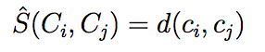
Cluster validation
Cohesion measures clustering effectiveness within a cluster.
Separation measures clustering effectiveness between clusters.
Notes:
Distance between centroids in different clusters

Slide 48
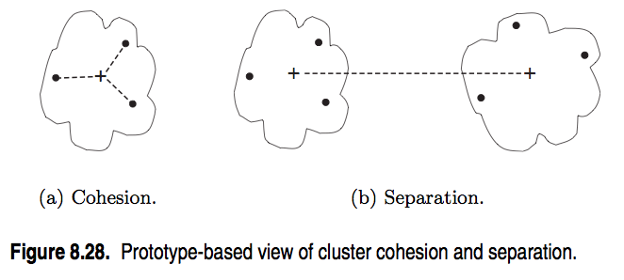
Cluster validation
source: http://www-users.cs.umn.edu/~kumar/dmbook/ch8.pdf
Notes:
In general, want cohesion to be low & separation to be high

Slide 49
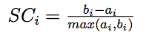
Silhouette coefficient
One useful measure than combines the ideas of cohesion and separation is the silhouette coefficient. For point x_{i}, this is given by:
such that:
a_{i} = average in-cluster distance to x_{i}
b_{ij} = average between-cluster distance to x_{i}
b_{i} = min_{j}(b_{ij})
Notes:
numerator = daylight between clusters
denom = largest length scale

Slide 50
Silhouette coefficient
The silhouette coefficient can take values between -1 and 1.
In general, we want separation to be high and cohesion to be low. This corresponds to a value of SC close to +1.
A negative silhouette coefficient means the cluster radius is larger than the space between clusters, and thus clusters overlap.
Notes:
(in k-means, this is pathological…overlapping clusters means pts are not assigned to nearest centroids!)

Slide 51
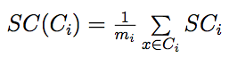
Silhouette coefficient
The silhouette coefficient for the cluster C_{i} is given by the average silhouette coefficient across all points in C_{i}:
Notes:
numerator = daylight between clusters
denom = largest length scale

Slide 52
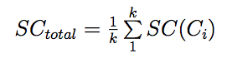
Silhouette coefficient
The silhouette coefficient for the cluster C_{i} is given by the average silhouette coefficient across all points in C_{i}:
The overall silhouette coefficient is given by the average silhouette coefficient across all clusters:
Notes:
numerator = daylight between clusters
denom = largest length scale

Slide 53

Silhouette coefficient
The silhouette coefficient for the cluster C_{i} is given by the average silhouette coefficient across all points in C_{i}:
The overall silhouette coefficient is given by the average silhouette coefficient across all points:
NOTE
This gives a summary measure of the overall clustering quality.
Notes:
numerator = daylight between clusters
denom = largest length scale

Slide 54
Cluster validation
One useful application of cluster validation is to determine the best number of clusters for your dataset.

Slide 55
Cluster validation
One useful application of cluster validation is to determine the best number of clusters for your dataset.
Q: How would you do this?

Slide 56
Cluster validation
One useful application of cluster validation is to determine the best number of clusters for your dataset.
Q: How would you do this?
A: By computing the SSE or SC for different values of k.

Slide 57
Cluster validation
Ultimately, cluster validation and clustering in general are suggestive techniques that rely on human interpretation to be meaningful.

Slide 58
STRENGTHS AND WEAKNESSES
Strengths:
K-means is a popular algorithm because of its computational efficiency and simple and intuitive nature.

Slide 59
STRENGTHS AND WEAKNESSES
Strengths:
K-means is a popular algorithm because of its computational efficiency and simple and intuitive nature.
Weaknesses:
However, K-means is highly scale dependent, and is not suitable for data with widely varying shapes and densities.

Slide 60
Ex: k-means clustering
INTRO TO DATA SCIENCE

